Slide 1
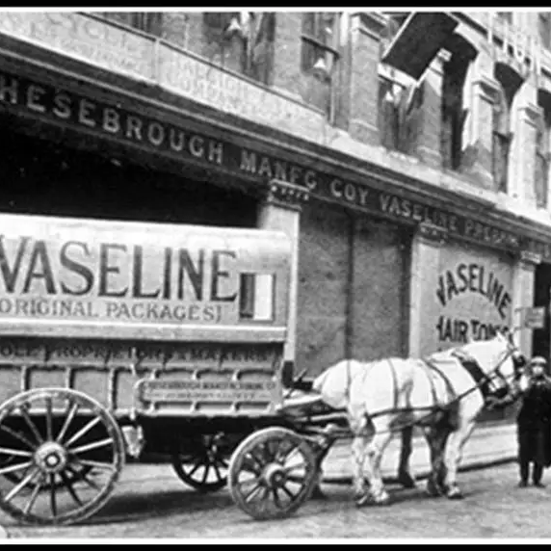
INVENTION OF VASELINE

Slide 2
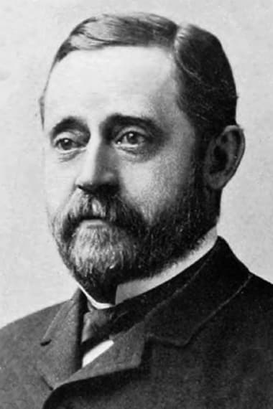
ROBERT CHESEBROUGH INVENTOR OF VASELINE
Vaseline, also known as petroleum jelly, was invented by Robert Chesebrough in 1872.
Chesebrough was a chemist who was interested in the properties of oil and its by-products. He had heard about a substance that oil rig workers were using to heal their cuts and burns, and he decided to investigate further.
Chesebrough travelled to the oil fields in Titusville, Pennsylvania, where he observed the workers using a thick, sticky substance that was left over after oil extraction.
The workers called this substance "rod wax," and they used it to treat their skin injuries.

Slide 3
Nomenclature
Chesebrough was intrigued by the healing properties of rod wax and began to experiment with it. He extracted the substance from the oil and refined it until it became a clear, odourless jelly. He named his creation "Vaseline" after the German word for water ("Wasser") and the Greek word for oil ("elaion").

Slide 4
Timeline - Chesebrough and Vaseline
1859
Chesebrough immigrates to the United States.
1860
Chesebrough begins working for a kerosene lamp manufacturer in Brooklyn, New York.
1870
Chesebrough becomes interested in the properties of oil and its byproducts.
1872
Chesebrough travels to the oil fields in Titusville, Pennsylvania, where he observes workers using a substance called "rod wax" to treat their skin injuries.
1872–1875
Chesebrough experiments with "rod wax" and refines it until it becomes a clear, odorless jelly that he names "Vaseline."
1875
Chesebrough establishes the Chesebrough Manufacturing Company to produce and market Vaseline.
1880s
Vaseline becomes widely recognized as a household product.
Chesebrough patents a process for making soap from glycerin, a byproduct of Vaseline production.
1905
Chesebrough is awarded the Franklin Institute's Elliott Cresson Medal.
1898

Slide 5
USES OF VASELINE
Moisturizing
Moisturizing skin: Vaseline can be used as a moisturizer to help hydrate and soothe dry skin. It forms a protective barrier on the skin that helps to prevent moisture loss and keeps skin hydrated.
Treating
Treating chapped lips: Vaseline can be used to moisturize and protect dry, chapped lips. It can be applied as a lip balm to help prevent further drying and cracking.
Healing
Healing minor cuts and burns: Vaseline can be applied to minor cuts and burns to help protect the wound and promote healing.
Preventing
Preventing diaper rash: Vaseline can be applied to a baby's bottom to create a protective barrier and prevent diaper rash.
Removing
Removing makeup: Vaseline can be used as a gentle and effective makeup remover. It can be applied to the skin with a cotton ball or swab and then wiped away with a clean cloth.

Slide 6

THANKYOU

